Slide 1

EDA on
Dmart Store

Slide 2

Agenda
01
INTRODUCTION
02
SYSTEM DESIGN
03
IMPLEMENTATION
04
CONCLUSION

Slide 3

INTRODUCTION
DMart, is an Indian retail corporation that operates a chain of hypermarkets in India.
It was founded by Radhakrishna Damani in 2002
Its first store was opened in Powai, Mumbai. As of June 2023, it has 330 stores across 14 states in India.

Slide 4
EDA on Dmart Store
The EDA consists of 09 columns. Here we have 09 features using this we start data analysis of Dmart Store
This data set consists of information: .
Name
Brand
Price Discounted
Price
Category
Subcategory
Quantity
Description
Breadcrumbs

Slide 5
SYSTEM DESIGN
Business
Understanding
Data
collection
Data
Preprocessing
Data Visualization
Descriptive analysis
Data cleaning

Slide 6
IMPLEMENTATION
Required Libraries to be imported :
import numpy as np
import pandas as pd
import seaborn as sns
import matplotlib.pyplot as plt

Slide 7







DATA PREPROCESSING
Loading Data:
df=pd.read_csv("G:\datascience\layoffs_data.csv")
Shape Of Dataframe
df.shape
o\p
(2738, 14)

Slide 8
DATA CLEANING
Checking for missing values
#code
df.isnull().sum()
Name 1
Brand 400
Price 1
DiscountedPrice 1
Category 3
SubCategory 3
Quantity 1
Description 2
BreadCrumbs 3

Slide 9
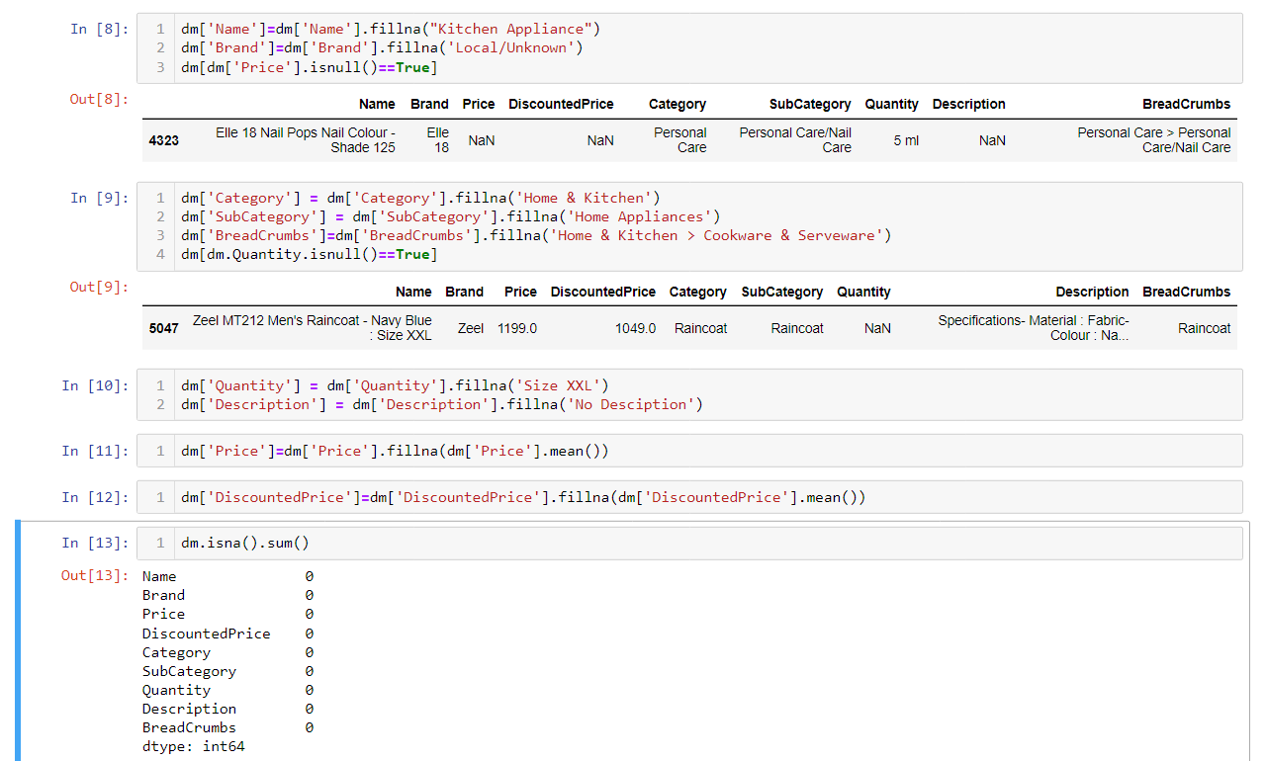
End of data cleaning

Slide 10

End of Data Preprocessing

Slide 11




EXPLORATORY DATA ANALYSIS

Slide 12
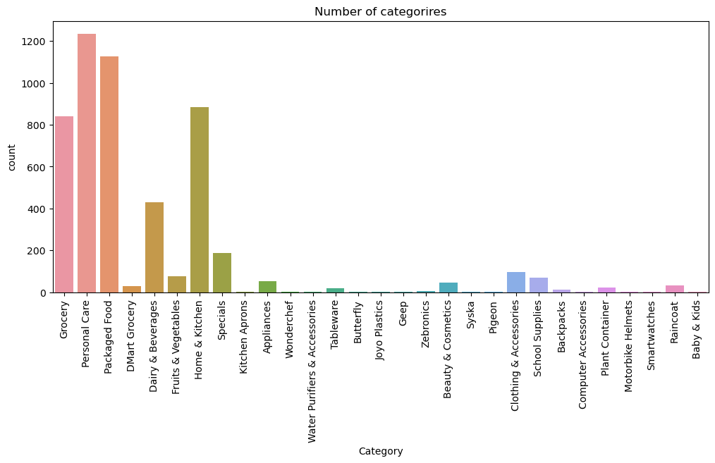
Q1.
what are the number of categories present in dmart?

Slide 13

Personal care is the highest Category Present in dmart

Slide 14
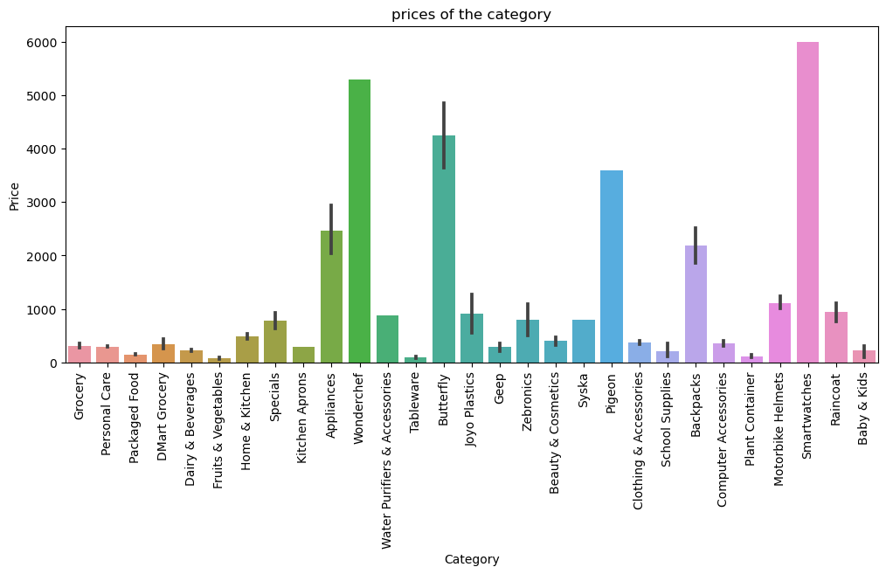
Q2.
what are the different prices of the categories in dmart?

Slide 15

In Dmart smartwatch category has the highest price

Slide 16
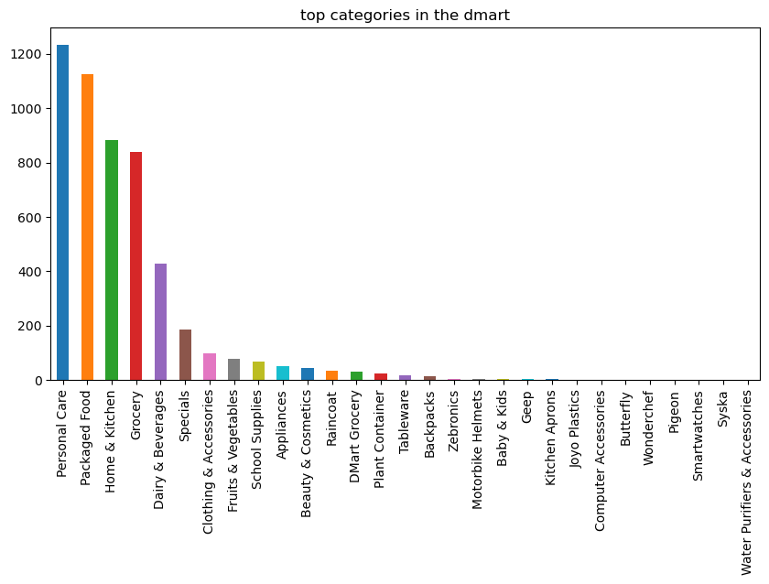
Q3.
what are the top categories present in dmart?

Slide 17
Personal care is the highest Category Present in dmart

Slide 18
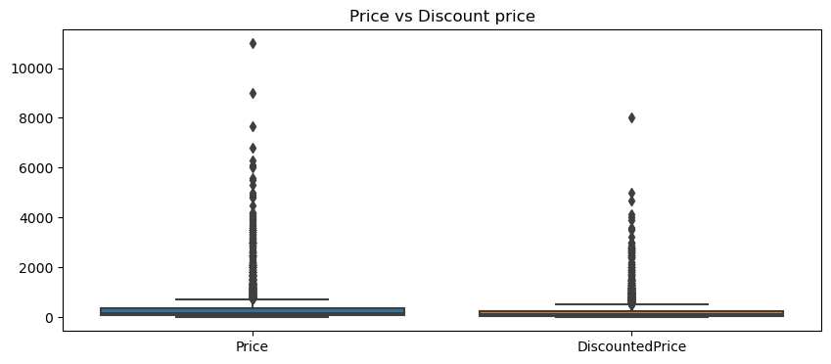
Q4.
what is the price vs discounted price in dmart?

Slide 19
Q5.
what are the list of the subcategories present in the dmart?

Slide 20
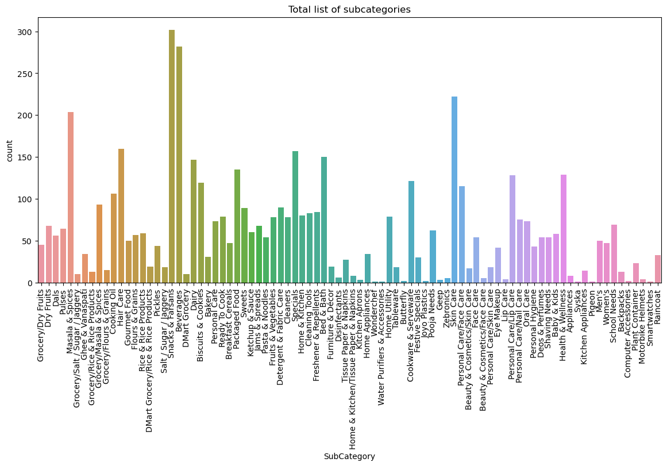
Personal care is the highest Category Present in dmart

Slide 21
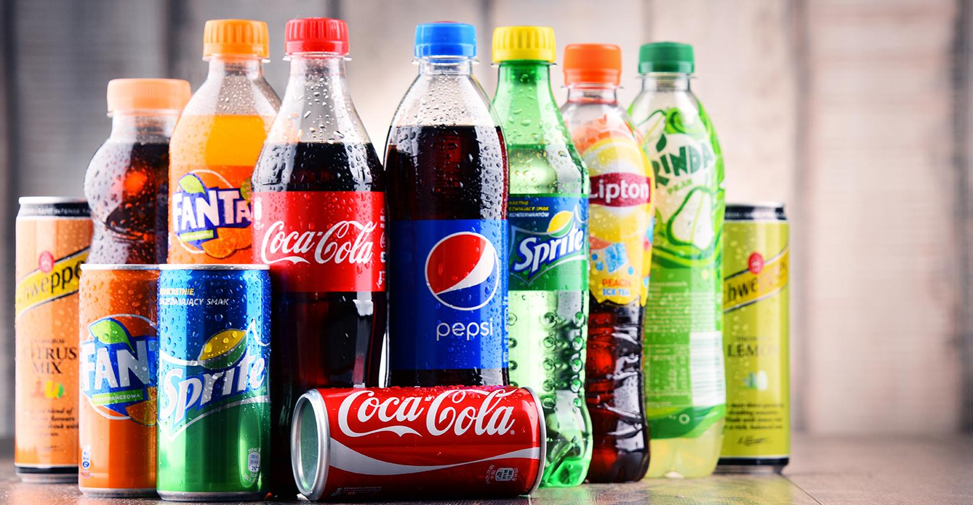
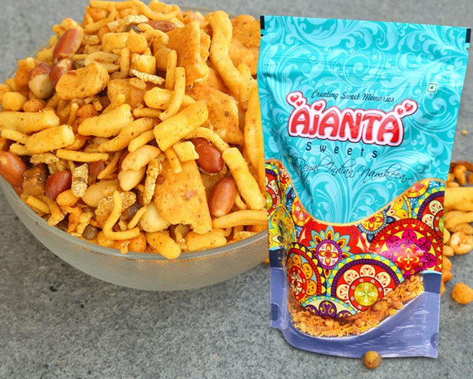
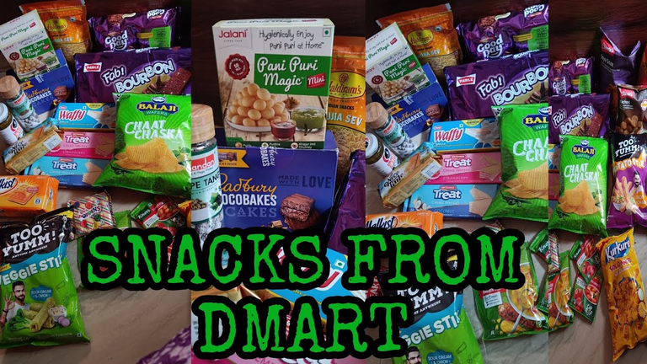
Subcategory in dmart
Snacks and Farsans is the highest subcategory followed by Beverages

Slide 22

Q6.
What is the discounted price of the subcategories in the dmart?

Slide 23
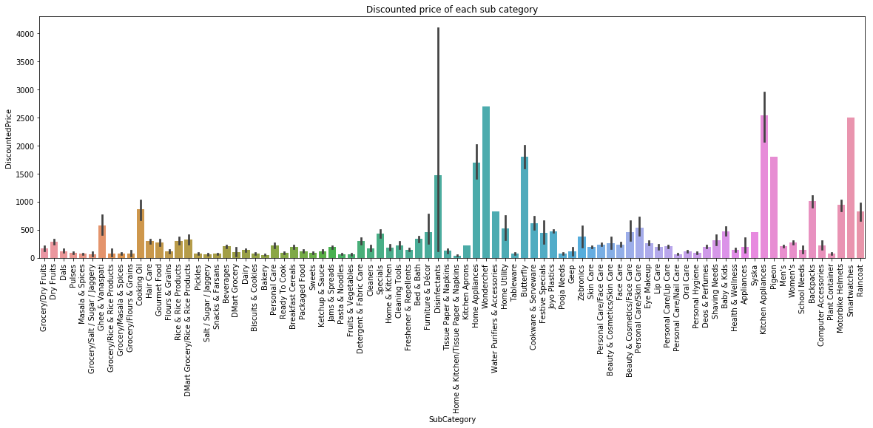

Slide 24
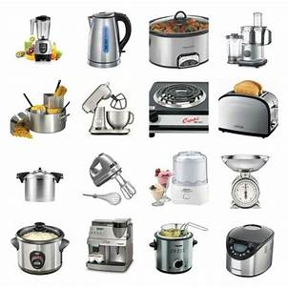
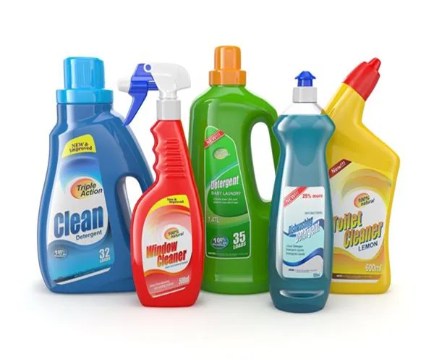
DISCOUNTED PRICE OF THE SUBCATEGORIES IN THE DMART
Highest Discounted Subcategory is Disinfectanats

Slide 25
Q7. What is the breadcrumbs present in the dmart?

Slide 26
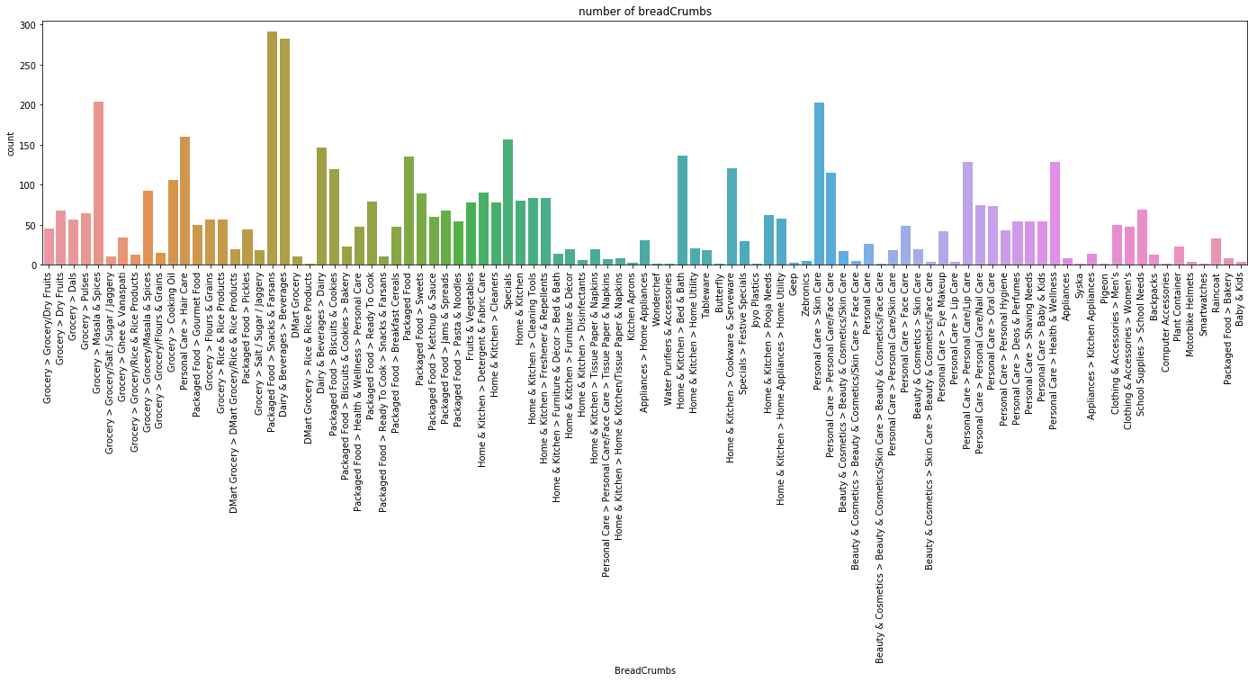
Packed food >Snacks and Farsans are the highest breadcrumbs present in dmart store
Followed by dairy and Bevereages

Slide 27
Q8. What are the prices of the breadcrumbs in dmart?

Slide 28
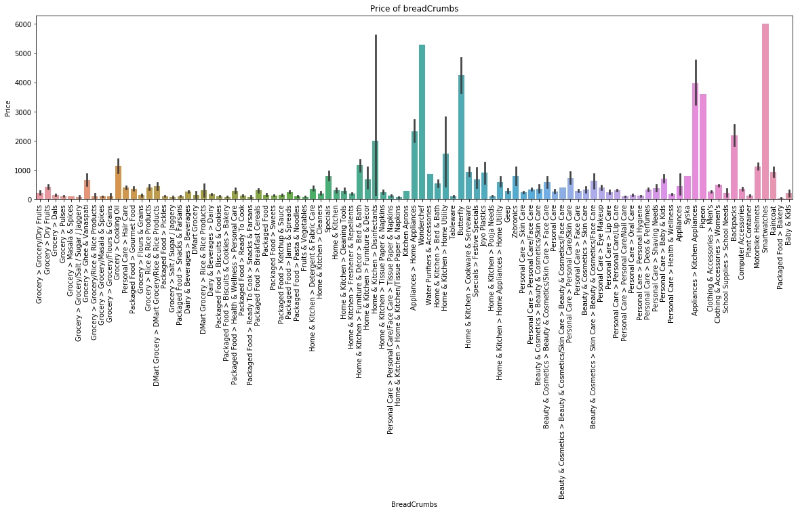
Smartwatch has the highest price
followed by kitchen appliances

Slide 29
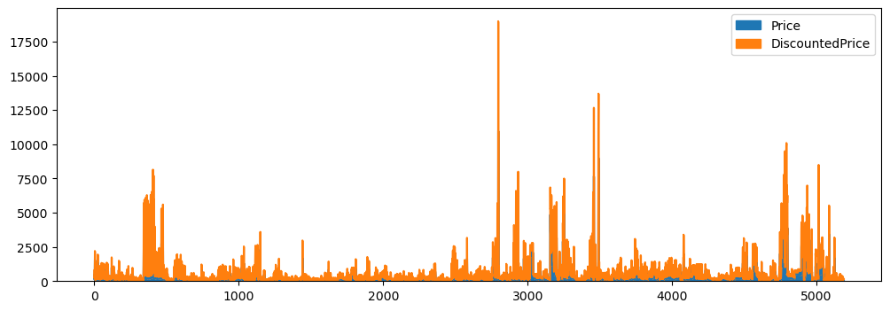
Q9.
What is the comparison of price vs discount price in dmart?

Slide 30
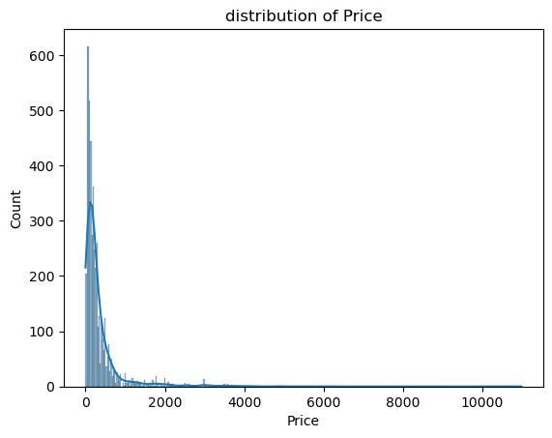
Q10.
What is the price distribution in dmart?

Slide 31
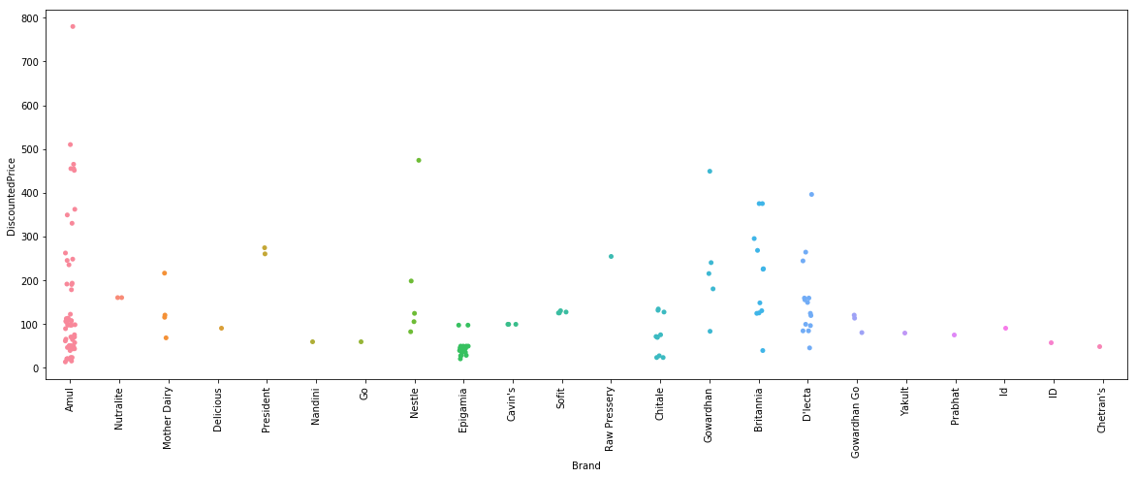
Q11.
Now i wish to see for Category Dairy’s Discounted Price

Slide 32
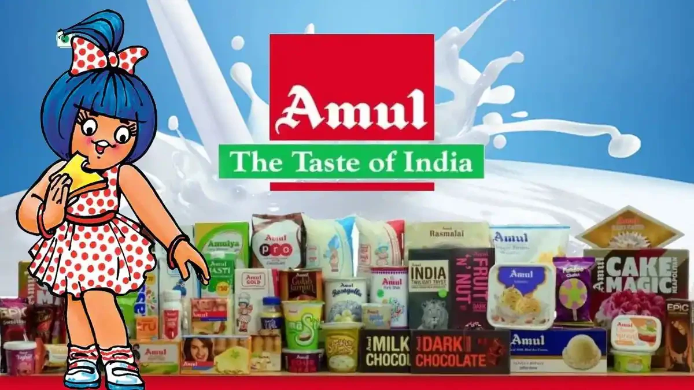
Amul dairy product has the highest discounted price

Slide 33
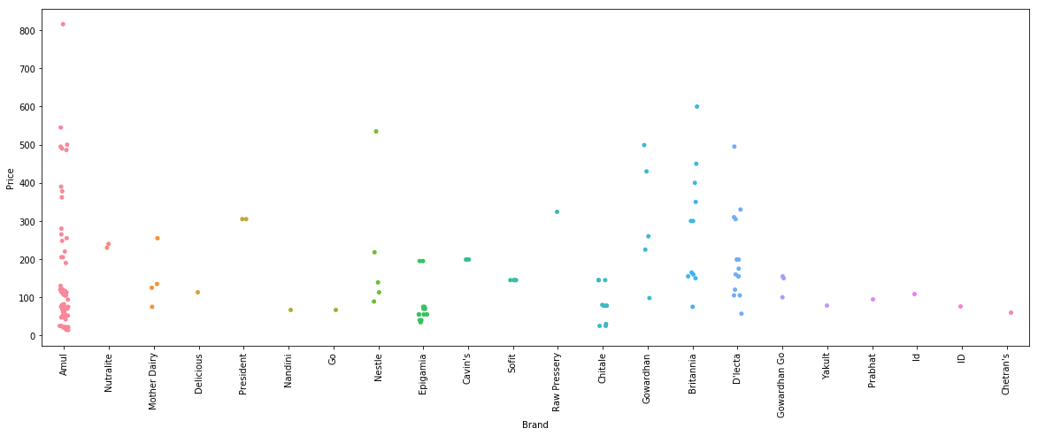
Q12.
Now I wish to see for Category Dairy’s Price

Slide 34
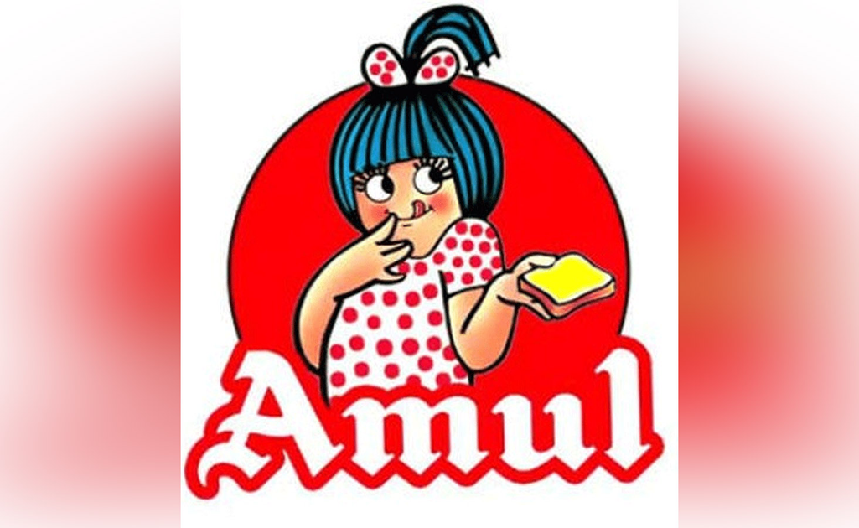
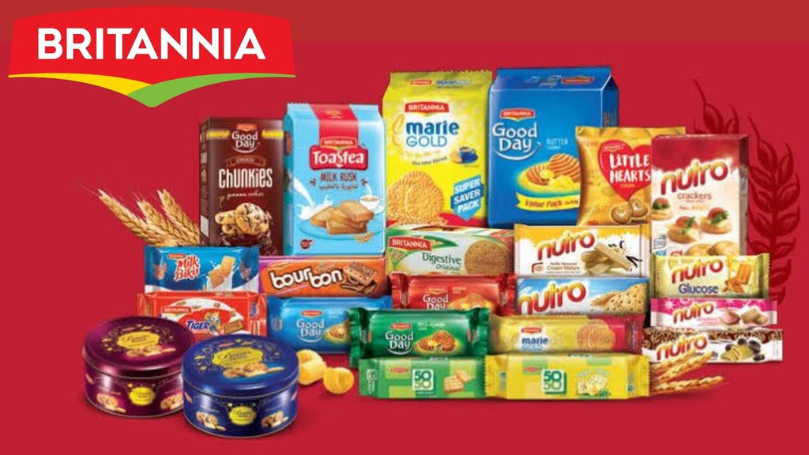
Amul dairy product has the highest price followed by Britannia product

Slide 35

Q13.
Count of each brand in Subcategory Beverages

Slide 36
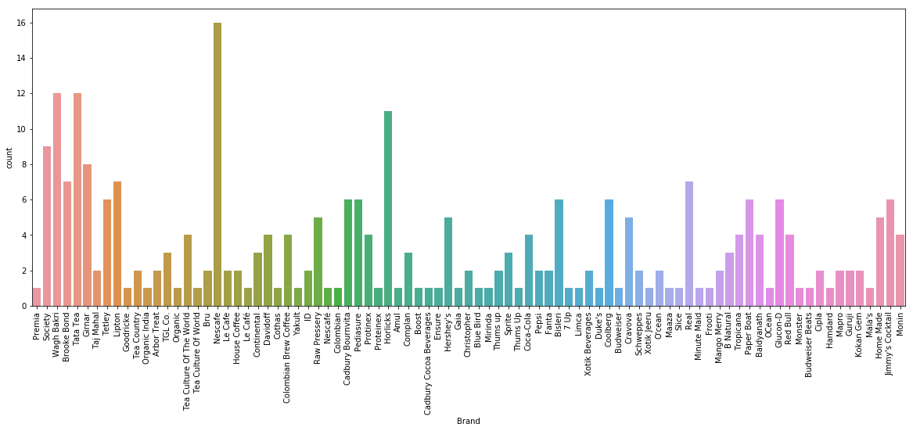

Slide 37
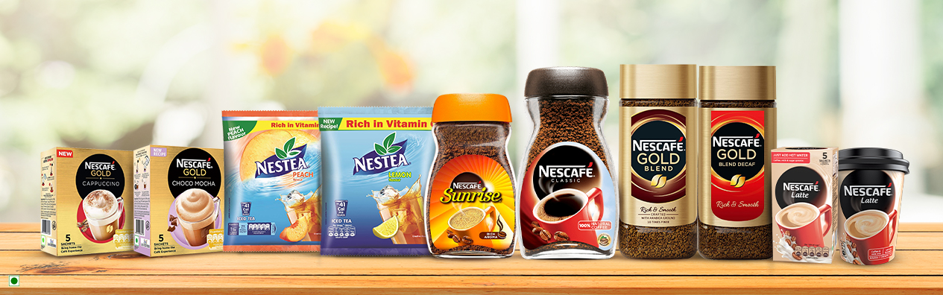
Nescafe product is highest Beverage subcategory

Slide 38
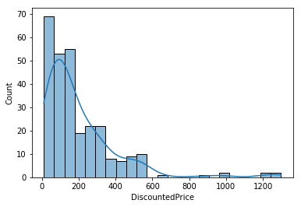
Q14.
Beverages and Discounted Price

Slide 39
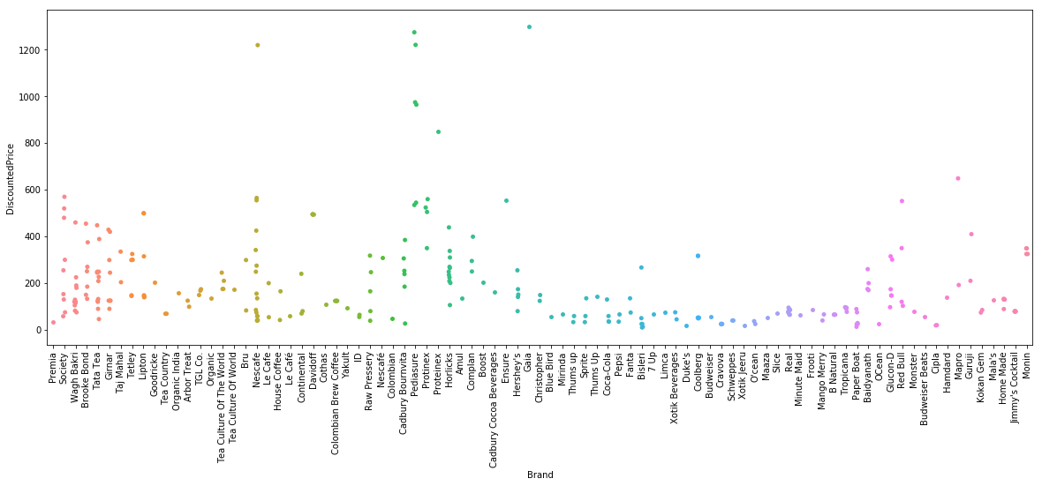
Q15.
Beverages Brand and Discounted Price

Slide 40
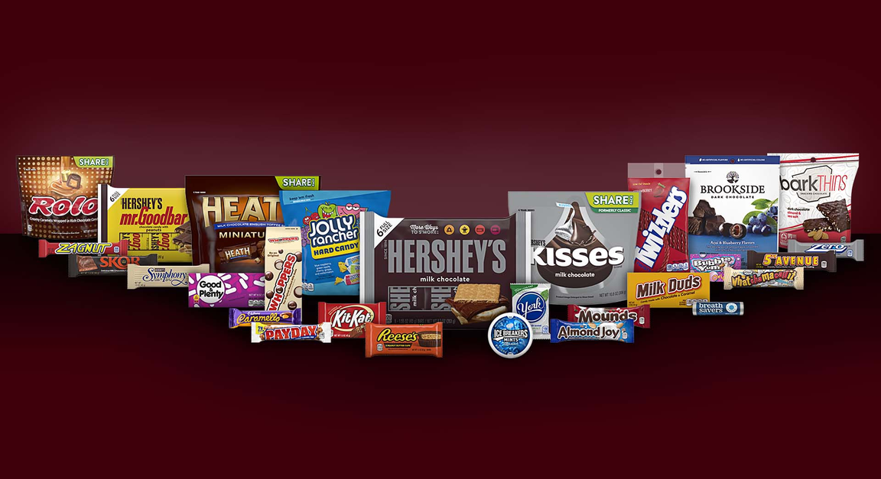
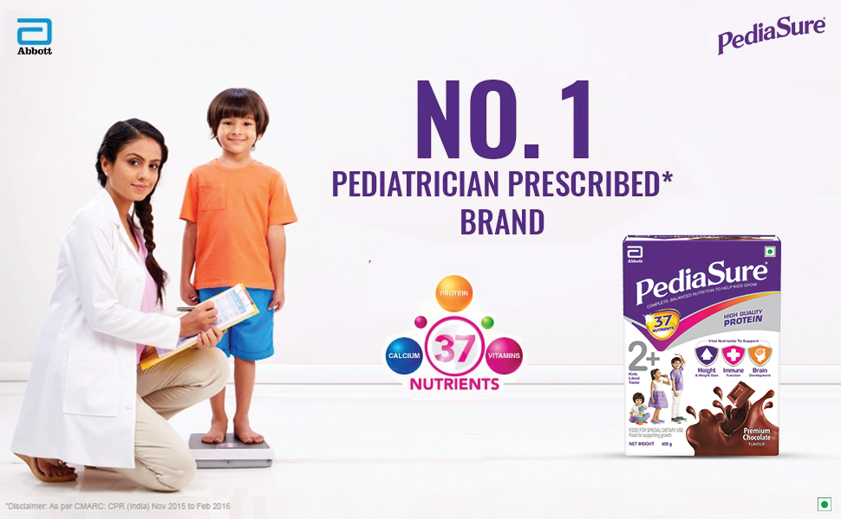
Hershey’s has the highest discounted price followed by PediaSure

Slide 41
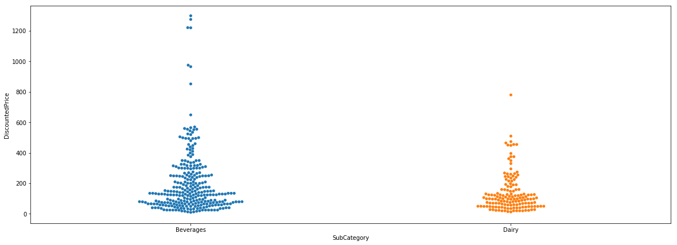
Q16.
Variations of Discounted Price between two Subcategories
Among 2 subcategories which is Beverages and Dairy, Beverages has the highest discounted price

Slide 42
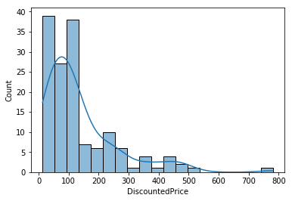
Q17.
Dairy and Discounted Price

Slide 43
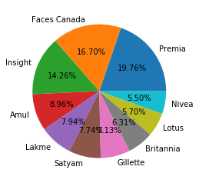
Q18.
Personal Care Subcategory

Slide 44
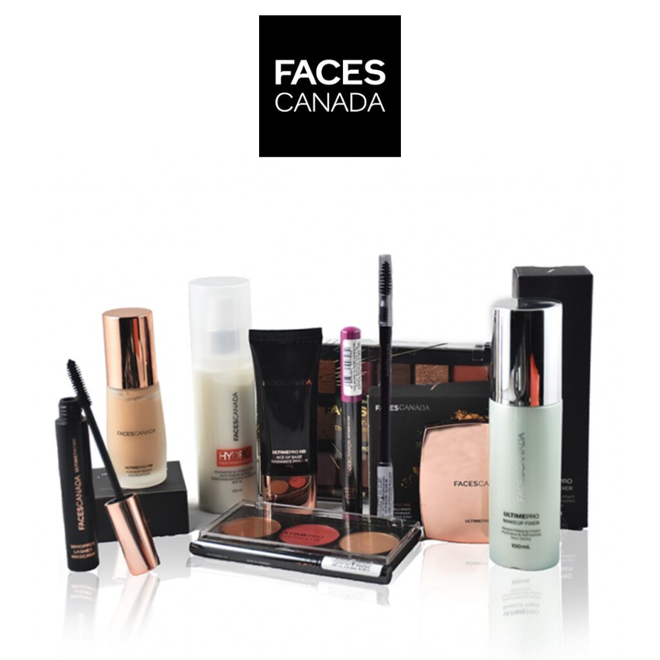
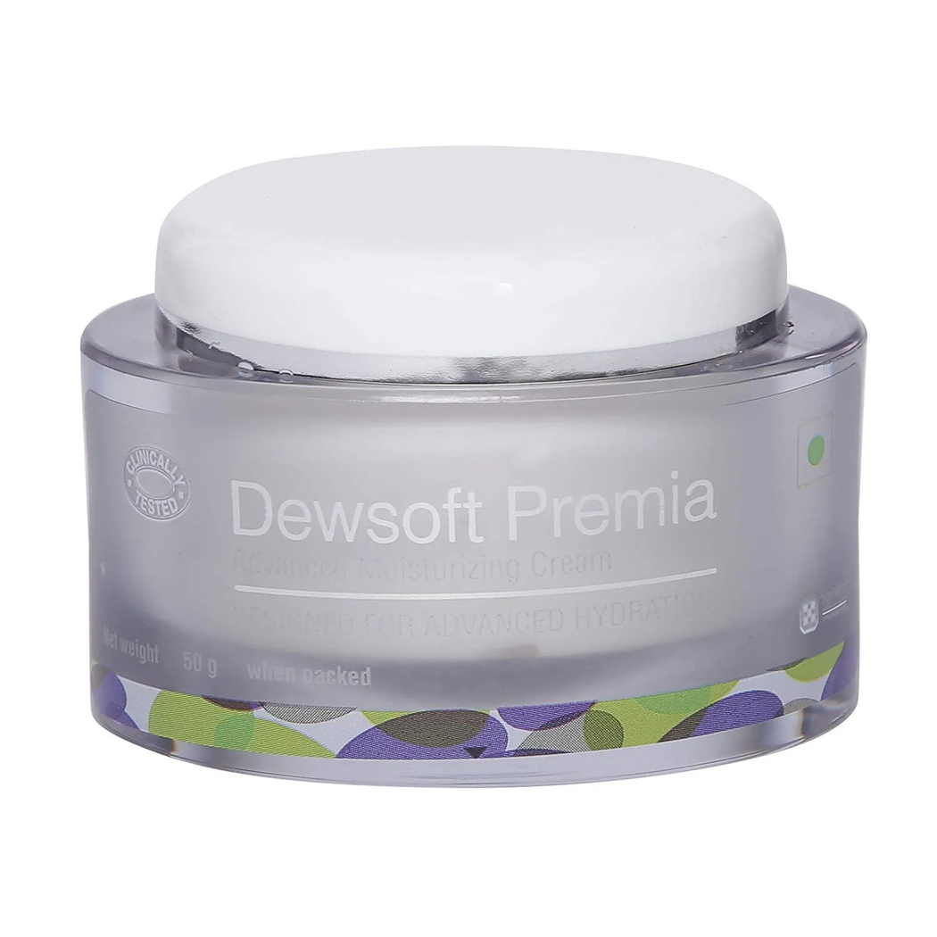
Faces canada is the second highest product in personal care subcategory
The least product is Nivea product
Premia Product is more compared to other products in Subcategory Personal Care

Slide 45
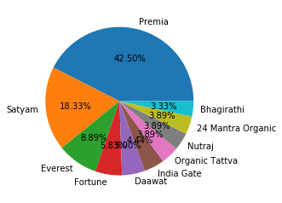
Q19.
Grocery Subcategory

Slide 46
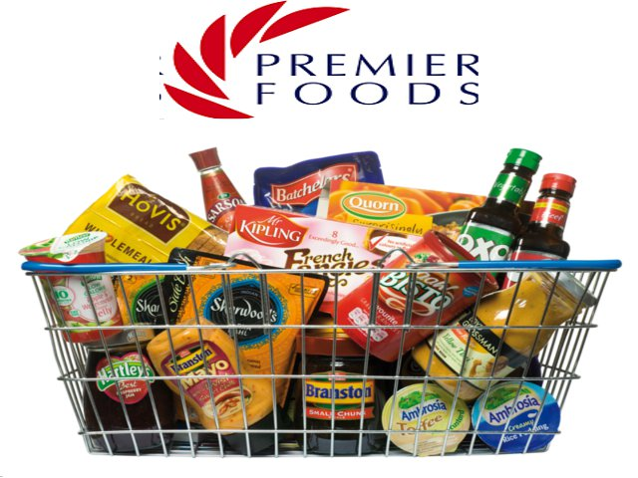
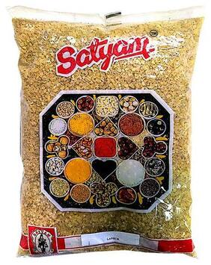
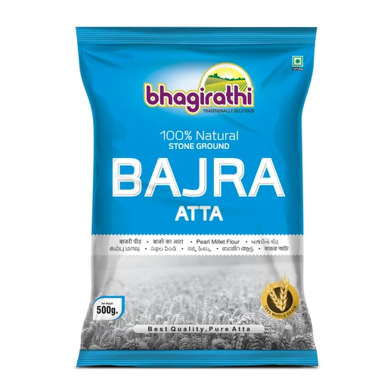
Premia Grocery has the highest product present in Grocery Subcategory
Satyam Grocery is the second highest product and the least product is Bhagirathi product in Grocery Subcategory

Slide 47
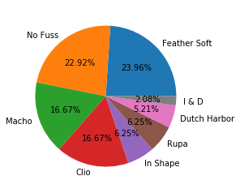
Q20.
Clothing and Accessories Subcategory
Feather soft and the
No Fuss products are the highest products present in Dmart
I&D are the least products present in Dmart

Slide 48
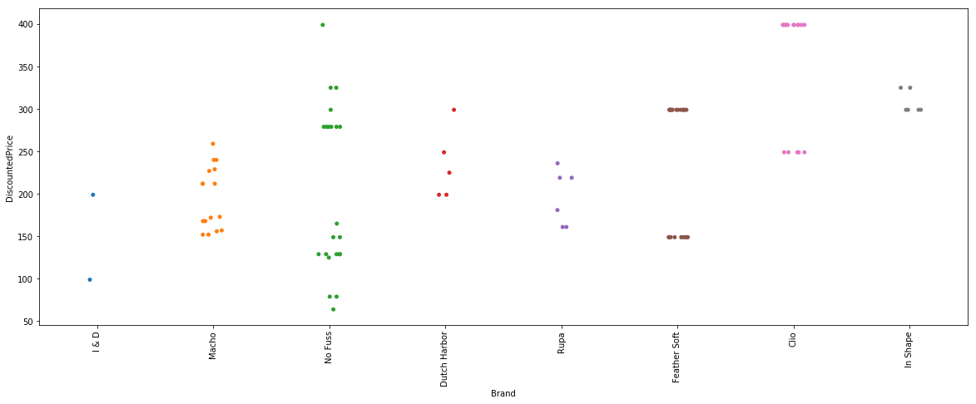
Q21.
Clothing and Accessories Subcategory Discounted Price
No Fuss and Clio are the two products which have the highest discounted price

Slide 49
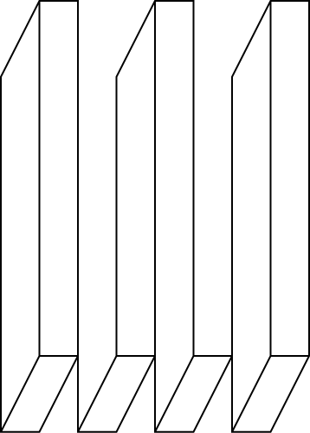
Conclusion
Add more text
Out of all Category Diary and Beverages contributes overall 6.20% profit
Between Dairy and Beverages more of the profit comes from Beverages Section
In Beverages Section the best selling brand is Nescafe with the spread of item discount price range of 10 to 1299
In Dairy Section the best selling brand is Amul with the spread of item discount price range of 13 to 780
Further analysis can be done on this dataset using the different methods and considering different Category

Slide 50

THANK YOU

